Slide 1
Single Cell Sequencing for the stem cells subjected to radiation
Lei Xu
Introduction to New Technologies in Data Science
May 2018

Slide 2
Project Scheme
Control
Single cell suspension
2.0 Gy space𝛾-Ray
Tissue harvest
Tissue dissociation
1.4 Gy ²⁸Si
10X Genomics Library Construction
Analysis
Mechanism Elaboration
RNA Sequencing
Aims
Check the gene expression of the Stem cell and to find the effect of the space radiation on the stem cell differentiation
Methods
Run cellranger pipeline on the biowulf2
Further analysis on Rstudio (CellrangerRkit): clustering, heatmap,
Notes:
What is the sample size for case and control group?

Slide 3
Running pipe line
#copy the Raw data Bcl2 file to the Biowulf2
rsync -av xul8@Pamuk.nci.nih.gov:/home/solexa/180411_NB501402_0113_AHWWJ5BGX3 .
#apply jobs
sinteractive --time=1-12:00:00 --mem=36g --cpus-per-task=8
#Biowulf pipeline
module load cellranger/2.1.1
module load bcl2fastq/2.20.0
cellranger mkfastq --run=/data/xul8/180411_NB501402_0113_AHWWJ5BGX3 --samplesheet=TisseTest.csv
cellranger count --id 10X_G_TissueTest --fastqs HWWJ5BGX3/outs/fastq_path --transcriptome=$CELLRANGER_REF/mm10 --indices=SI-GA-C1

Slide 4
Analysis with the CellrangerRkit package on Rstudio
library(cellrangerRkit)
lgr5testpath<- "/Volumes/lei/scRNAseq/Lgr5_test1”
datatestdata<-load_cellranger_matrix(lgr5testpath)
test_analyzed<- load_cellranger_analysis_results(lgr5testpath)
tsne_test<-test_analyzed$tsne
use_genes<-get_nonzero_genes(testdata)
testdata_norm<-normalize_barcode_sums_to_median(testdata[use_genes,])
testdata_log<-log_gene_bc_matrix(testdata_norm, base=10)
genes<-c("Alcam","Ascl2",'Bmi1',"Bmpr1a", 'Alk','Cd24a','Dclk1','Ephb2','Lgr5','Sox9','Hopx','Itgb1','Igfbp4','Lrig1','Tert','Olfm4','Phlda1','Prom1','Smoc2','Tnfrsf19’)
visualize_gene_markers(testdata, genes, tsne_test[c("TSNE.1", "TSNE.2")], limits = c(0,2.5))

Slide 5
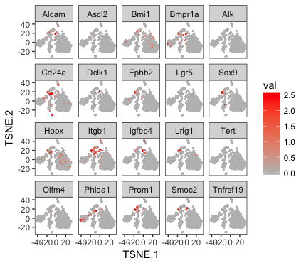
Stem cell marker genes distribution

Slide 6
Check the clusters classfication
n_clu<-2:10
km_res<-test_analyzed$clustering
clu_res<- sapply(n_clu, function(x) km_res[[paste("kmeans",x,"clusters",sep="_")]]$Cluster)
colnames(clu_res)<-sapply(n_clu, function(x) paste("kmeans",x,sep="."))
visualize_clusters(clu_res,tsne_test[c("TSNE.1","TSNE.2")])

Slide 7
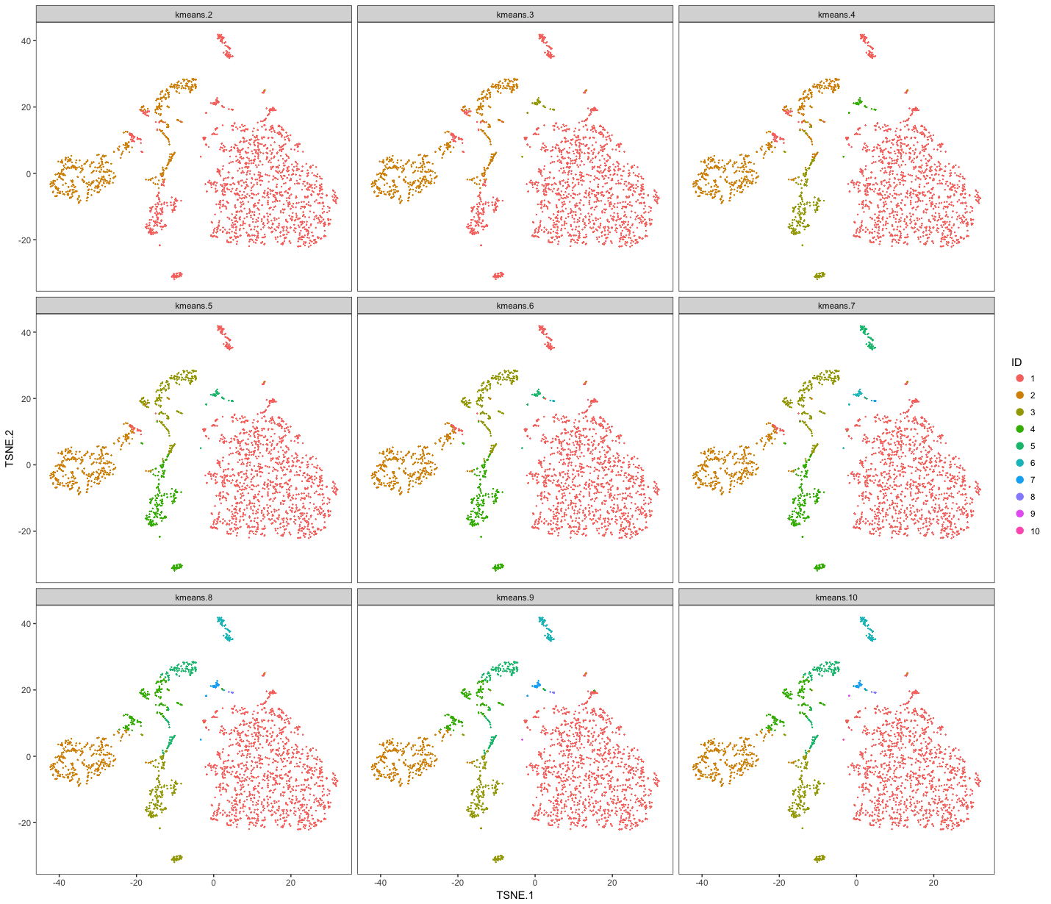
Clusters

Slide 8
example_k<- 5
example_col <- rev(brewer.pal(example_k, "Set2"))
cluster_results<- test_analyzed$clustering[[paste("kmeans", example_k, "clusters", sep = "_")]]
visualize_clusters(cluster_results$Cluster,tsne_test[c("TSNE.1","TSNE.2")], colour = example_col)

Slide 9
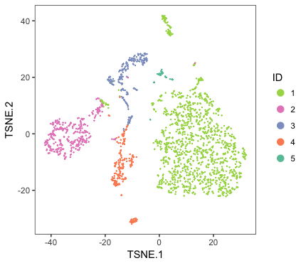
We would like to use 5 clusters

Slide 10
Heatmap of the top 10 genes in each cluster
cells_to_plot<- order_cell_by_clusters(testdata, cluster_results$Cluster)
prioritized_genes<- prioritize_top_genes(testdata, cluster_results$Cluster, "sseq", min_mean = 0.5)
gbm_pheatmap(log_gene_bc_matrix(testdata), prioritized_genes, cells_to_plot, n_genes = 10, colour = example_col, limits = c(-1,2))

Slide 11
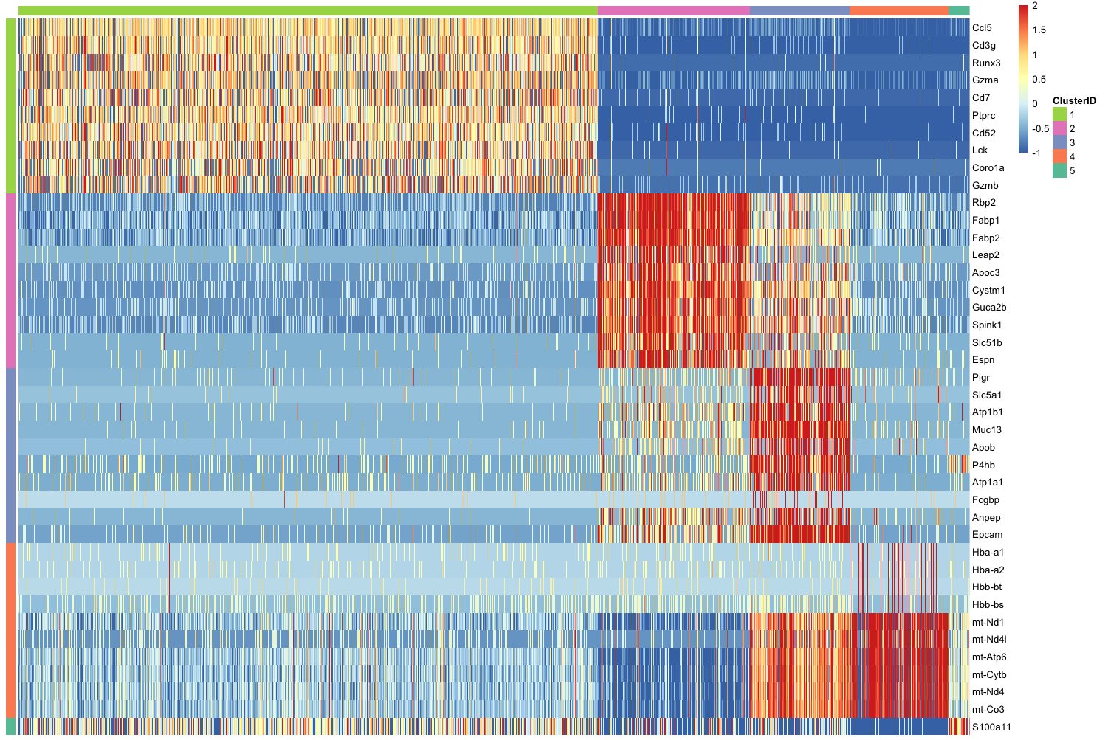
Heatmap of the top 10 genes in each cluster

Slide 12
Check the cell type of the clusters
cluster_top_gene<-read.table("Cluster_1_symbol.tsv")
cluster_top_gene<-sort(c(as.character(cluster_top_gene$V1)))
visualize_gene_markers(testdata, cluster_top_gene[12:23], tsne_test[c("TSNE.1", "TSNE.2")], limits = c(0,2.5),title = "cluster1")

Slide 13
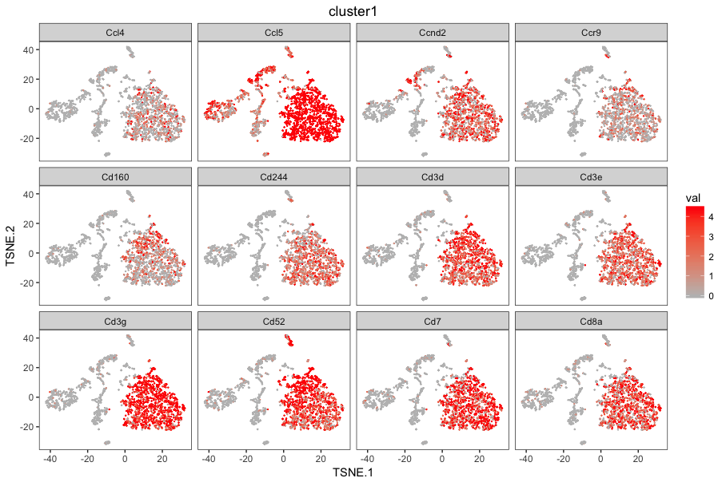
Check the cell type of the clusters

Slide 14
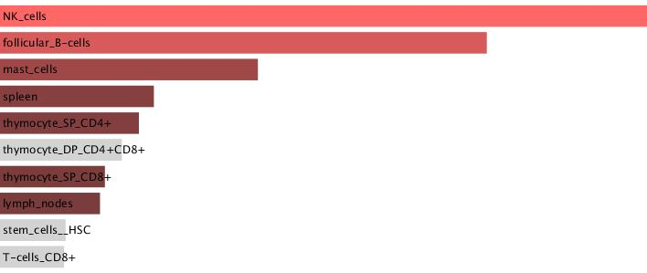
Analysis the cell type of cluster1

Slide 15
Multipul samples pipeline—get the fastq files
#Creat the swarm file
Nano scRNA_Seq.swarm
#!/bin/bash
cellranger mkfastq --run=/data/xul8/180425_NS500391_0200_AH53G3BGX5 --samplesheet=AH53G3BGX5_4_lgrGFP.csv
cellranger mkfastq --run=/data/xul8/180425_NB501402_0117_AH55KNBGX5 --samplesheet=AH55KNBGX5_5_lgr5GFP.csv
#Run the swarm file
swarm -f scRNA_Seq.swarm --time 1-12:00:00 -g 50 -t 10 --module bcl2fastq/2.20.0,cellranger/2.1.1

Slide 18
Multiple samples pipeline—get the gene count
#Creat the swarm file
nano scRNA_Seq_counts.swarm
#!/bin/bash
cellranger count --id lgr5_Con1 --sample lgr5GFP_Con1 --fastqs H53G3BGX5/outs/fastq_path --transcriptome=$CELLRANGER_REF/mm10 --indices=SI-GA-E1
cellranger count --id lgr5_Con4 --sample lgr5GFP_Con4 --fastqs H53G3BGX5/outs/fastq_path --transcriptome=$CELLRANGER_REF/mm10 --indices=SI-GA-F1
cellranger count --id lgr5_Gamma2 --sample lgr5GFP_Gamma2 --fastqs H53G3BGX5/outs/fastq_path --transcriptome=$CELLRANGER_REF/mm10 --indices=SI-GA-G1
cellranger count --id lgr5_Gamma3 --sample lgr5GFP_Gamma3 --fastqs H53G3BGX5/outs/fastq_path --transcriptome=$CELLRANGER_REF/mm10 --indices=SI-GA-H1
cellranger count --id lgr5_Con2 --sample lgr5GFP_Con2 --fastqs H55KNBGX5/outs/fastq_path --transcriptome=$CELLRANGER_REF/mm10 --indices=SI-GA-A2
cellranger count --id lgr5_Con3 --sample lgr5GFP_Con3 --fastqs H55KNBGX5/outs/fastq_path --transcriptome=$CELLRANGER_REF/mm10 --indices=SI-GA-B2
cellranger count --id lgr5_Gamma1 --sample lgr5GFP_Gamma1 --fastqs H55KNBGX5/outs/fastq_path --transcriptome=$CELLRANGER_REF/mm10 --indices=SI-GA-C2
cellranger count --id lgr5_Gamma4 --sample lgr5GFP_Gamma4 --fastqs H55KNBGX5/outs/fastq_path --transcriptome=$CELLRANGER_REF/mm10 --indices=SI-GA-D2
cellranger count --id lgr5_Gamma5 --sample lgr5GFP_Gamma5 --fastqs H55KNBGX5/outs/fastq_path --transcriptome=$CELLRANGER_REF/mm10 --indices=SI-GA-E2
# run the swarm file
swarm -f scRNA_Seq_counts.swarm --time 1-12:00:00 -g 50 -t 10 --module bcl2fastq/2.20.0,cellranger/2.1.1

Slide 19
Future work
Analyze the multi samples
Modify the experiment protocal
Find the related genes during the cell differentiation

Slide 20
Achowledge
Antej Nuhanovic

